Slide 1


Simple Selectors

Slide 2

Topics
Tagname selector
Id selector
Class selector
Universal selector
Grouping selector
Three Commonly used CSS selectors

Slide 3

Selectors in CSS
In CSS, a selector is a pattern that identifies which HTML elements on a web page should be targeted and styled

Slide 4
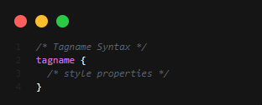
Tagname selector
A tag-name selector in CSS targets HTML elements based on their tag name.

Slide 5
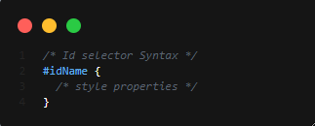
Id selector
An ID selector in CSS targets a specific HTML element based on its unique ID attribute value

Slide 6
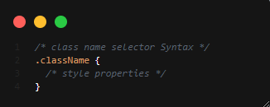
Class Selector
A class selector in CSS targets HTML elements based on their class attribute value or class name.

Slide 7
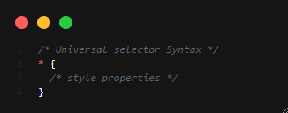
Universal selector
The universal selector in CSS is represented by an asterisk (*). It can be used to select all elements in a document.

Slide 8
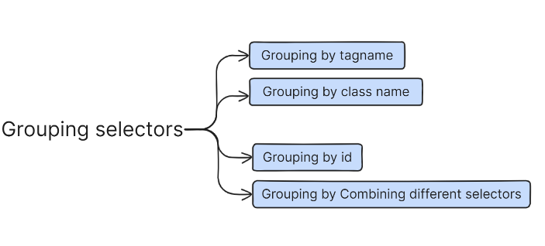
Grouping Selectors
In CSS, grouping selectors allow you to apply styles to multiple elements with a single rule, reducing the amount of repetitive code.

Slide 9
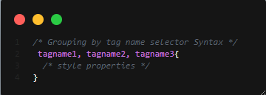
Grouping by tag name
Selecting multiple tag names together to apply the same styles to all elements with the same tag name.

Slide 10
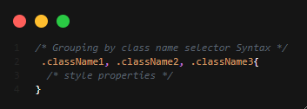
Grouping by class name
Selecting multiple class names together to apply the same styles to all HTML elements with the corresponding class name.

Slide 11
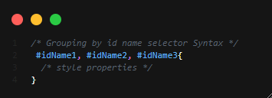
Grouping by ID
Although IDs should be unique in HTML, you can still group them in CSS selectors.

Slide 12
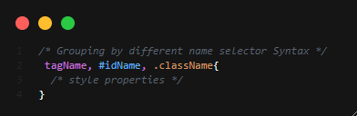
Grouping by combining different selectors
Selecting multiple different selectors' names together to apply the same styles to all the corresponding HTML elements respectively.

Slide 13
Three Commonly Used CSS Selectors
Class selector
Id selector
Tagname selector

Slide 14

THANK YOU

